Slide 1
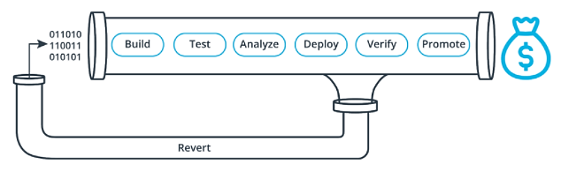
CI/CD Benefits

Slide 2

Increase revenue
New value-generating features released more quickly as production deployment will be faster and more frequent.
Less time to market as we will able to deploy to production without time consuming manual check

Slide 3

Protect revenue
Reduced downtime from a deploy-related crash or major bug as smoke tests will be automatized.
Quick undo to return production to working state: if something went wrong rollback is automatic.

Slide 4

Reduce costs
Less developer time on issues from new developer code
Less infrastructure costs from unused resources: infrastructure deployment is also automatized and useless infra automatically deleted.

Slide 5

Avoid costs
Less bugs in production and less time in testing
Prevent embarrassing or costly security holes
Less human error, Faster deployments

Slide 6
For all these good reasons, we think Continious Deployment is very interesting to increase the competitivity of ours products

